Slide 1
President/Treasurer Secretary/Trustee Workshop
Trustees
Secretary
Compiled by:
Marilyn Malick, Past Department President
(586)536-6004
MJMalick@msn.com
Updated July 1, 2019
Treasurer

Slide 2
Norms
Cell phones on vibrate
Keep sidebar conversations to a minimum
Participate
Ask questions
Respect others
Take care of yourself
Be open-minded and positive

Slide 3
Topics Covered
PRESIDENT
Best Practices
Duties
Be Prepared
TREASURER
Treasurer’s Guide
New Treasurers-Notifying the IRS
990-N ePostcard
Direct Deposits
Bonding
Cancer Insurance and Grants
Auxiliary Treasurer’s Report
Retention of Records
Membership

Slide 4
Topics Covered (cont.)
SECRETARY
Duties of Auxiliary Secretaries
Minutes of the Meeting
Helpful Hints
TRUSTEES
Duties of the Trustees
Audit Preparation
Performing an Audit
Notes:
Lesson descriptions should be brief.

Slide 5
Auxiliary President Best Practices
Your attitude sets the tone for your year, so make sure it is positive
The National and Department websites have many resources to assist you in your duties
Sign up for the VFW Auxiliary e-newsletter at www.vfwauxiliary.org. It has up-to-date information on many subjects and keeps you connected to National headquarters
Activate your MALTA account!!!
Make sure you have a current edition of the National Bylaws and Ritual
Work as a team with your Commander

Slide 6
Auxiliary President Duties (Section 810 and 810A)
Preside and maintain order at all meetings
See that there is no disruption during the meeting and if so, have the member causing the disruption removed
Appoint all officers and committees not otherwise provided for
Within 30 days of taking office, submit your last quarterly audit and a membership report to your Commander (Section 810)
Register for the National Convention if attending
Countersign all checks drawn by the Treasurer

Slide 7
Auxiliary President Duties (Section 810 and 810A) (cont.)
Appoint a committee of not less than five (5) members, including the Treasurer, to contact all members during the year for payment of dues
See that all reports are correctly made out and promptly forwarded
See that the business of the Auxiliary is transacted in a proper and efficient manner

Slide 8
Auxiliary President-Be Prepared
Be ready for your meetings with an agenda, current National Bylaws, gavel and any correspondence you have received to hand to your Secretary.
Highlight your part of the meeting in the Ritual section of the National Bylaws.
Before every meeting make contact with your Secretary and Treasurer for any unfinished or new business that may need to be brought forth to the meeting floor
Make a list of your Chairmen so you don’t leave anyone out

Slide 9
Auxiliary President-Be Prepared (cont.)
Make sure all Officers have a current Ritual and know their parts
Start your meetings on time and keep the short and informative
Be enthusiastic with the programs and make sure you thank the Chairmen and everyone for attending and participating
Dress appropriately; you lead by example
If a question is asked that you cannot answer, be honest and tell them you do not know, but will find out the answer and report back. Honesty is the best policy.
Encourage members to attend District and Department meetings

Slide 10
Auxiliary President-Be Prepared (cont.)
As a voting member, you should attend District meetings
At your April meeting, election of Officers must be completed
Delegates and alternates for District, Department and National Convention should be completed and sent to the respective officer or submitted online in a timely manner
Help your Chairmen, but don’t be overbearing.
Understand and review your Auxiliary’s Standing Rules

Slide 11
Auxiliary President
Communicate with your members often and in a variety of ways
Set goals for your Auxiliary and be a team player
Be sure that your Officers get the training they need
Say “Thank You”

Slide 12
Treasurer’s Guide
A digital copy of the Treasurer’s Guide and all forms can be found online at http://vfwauxiliary.org/treasurer-resources

Slide 13
New Auxiliary Treasurer (Notifying the IRS)
You need to notify the IRS of change in responsible party
File form 8822-B with the IRS within 60 days of election
This ensures IRS correspondence goes to the new Treasurer
The form can be found on-line at www.irs.gov
Notes:
Example objectives
At the end of this lesson, you will be able to:
Save files to the team Web server.
Move files to different locations on the team Web server.
Share files on the team Web server.

Slide 15
990-N ePostcard
Auxiliaries whose gross receipts are normally less than or equal to $50,000 are required to electronically submit Form 990-N, also known as the ePostcard
The e-Postcard is due every year by the 15th day of the 5th month after the close of your tax year. This means the ePostcard is due by November 15th

Slide 16
990-N ePostcard (cont.)
To file a 990-N ePostcard
Register with the https://sa.www4.irs.gov/epostcard/ website
If you have already created a profile last year you are all set to do your new 990-N ePostcard
If you did not create a new profile do it and then respond to the activation email sent during the registration process
Complete and submit the 990-N ePostcard for an exempt organization

Slide 17
990-N ePostcard (cont.)
Remember, it will say 2018 tax year, as we are doing the 990 for July 1, 2018 through June 30, 2019
Due November 15, 2019
Send proof of 990 Completion to the Department office
If you have any issues with the website, call Nicole at the Department office

Slide 18
Direct Deposits
All funds to Departments, Districts, and Auxiliaries will be sent only via Electronic Funds Transfer (EFT), also known as ACH/Direct Deposit, from National Headquarters
You will be notified via e-mail that a deposit has been made into your bank account
File new ACH Authorization form if you change bank accounts or if the bank changes information
You can find the ACH Authorization Form on the National website at http://vfwauxiliary.org/treasurer-resources

Slide 19
President’s and Treasurer’s Bonds
Per Section 814 of Bylaws
Offices of the President and Treasurer must be bonded
Surety in a sum at least double the amount of funds and value of property for which they may be accountable. Amount to be approved by the body and premium paid from their funds
The office of President shall hold the original bond of both offices.
Bonds cover the office and not the individual
A copy of the bond covering both offices shall be incorporated into the minutes each year
If you have questions about the utilization of a bond, contact the Tallman Insurance Agency at 816-753-2345

Slide 20
President’s and Treasurer’s Bonds (cont.)
How do I purchase a bond?
Secretary inputs the installation report into MALTA
President and Treasurer will receive an e-mail indicating that the bond is ready to be purchased
Treasurer can then go on-line to the MALTA website and purchase the bond and print the bond receipt. You can now purchase it with the Auxiliary’s ACH instead of using your own credit card.
President and Treasurer’s MALTA account will show “Purchase Bond”. Once the Bond is purchased and processed, the account will show “Print Bond”.
If you prefer to mail in a bond application it can be found on-line at http://vfwauxiliary.org/treasurer-resources

Slide 21
Cancer Insurance
Cancer Insurance is no longer administered by National Headquarters
Not every Auxiliary carries Cancer Insurance
AMWINS handles all Cancer Insurance Issues
AMWINS
P.O. Box 535007
Grand Prairie, TX 75053
(877)853-4539 8am to 8pm (Eastern), M-F

Slide 22
Cancer Grants
Cancer Grant form available at http://vfwauxiliary.org/treasurer-resources.
Applicant must be a member of the VFW Auxiliary for one (1) full year.
Current dues must be paid before applying for a cancer grant
After twelve months have passed from date of diagnosis or last treatment, application will not be accepted
A member is allowed two grants during lifetime
The family of a deceased member can still receive a Cancer Grant within 30 days of death
Cancer Grants are now $550.00

Slide 23
Auxiliary Treasurer’s Report
At each Auxiliary meeting, the Treasurer shall make a report following the reading of the minutes
The Auxiliary Treasurer’s Report shall contain:
Balance on hand as of the last report (Beginning Balance)
Amount of funds received from all sources since the last report
Amount expended since last report
Balance on hand (Ending Balance)
The report must show all receipts and disbursements in detail, including the name of the person or organization to whom the check is issued and stating for what purpose

Slide 24
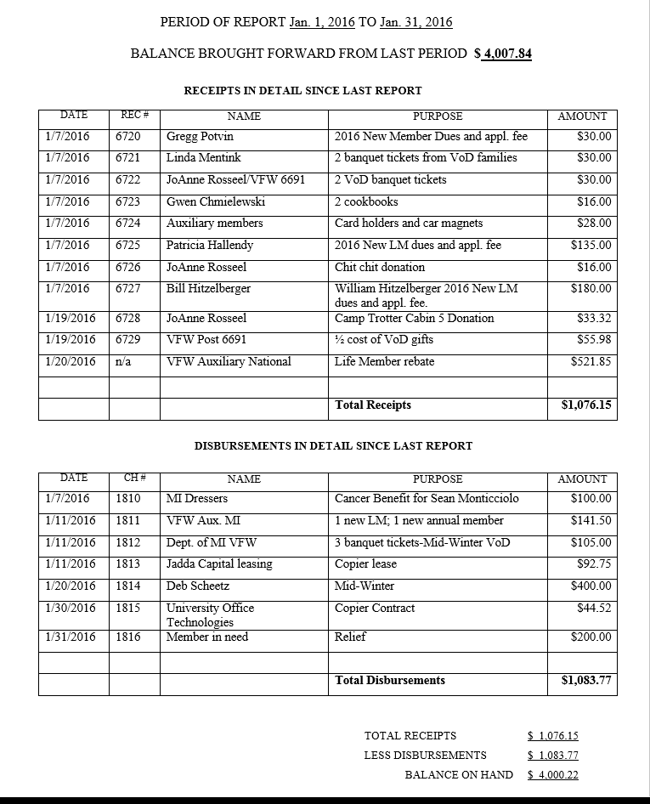

Slide 25
Auxiliary Treasurer’s Report
A copy of the Treasurer’s Report goes to the Secretary to be included in the minutes
As per the Auxiliary Order of Business, after the Treasurer’s report it is customary for the Presentation of Bills and later the Report of the Trustees and action thereon

Slide 26
Retention of Auxiliary Records
Most accounting records – 6 years
Accounts Receivables
Accounts Payables
Canceled Checks
Bank Statements
Retention Guides
Booklet of Instructions (yellow pages)
Treasurer’s Guide

Slide 28
New Members
Make sure entire application form is filled out
New member dues and application should be transmitted to your Department Treasurer as soon as member is accepted into your Auxiliary
The Department Treasurer will process New Members with National
Keep a copy of the New Member application for your Auxiliary records

Slide 29
Application/Investigating Committee
Article 1 Section 102 states that all applications shall be referred to an investigating committee of three (3):
Appointed by the President.
They shall make a careful investigation of the facts set forth in the application.
The committee shall see proof of the honorable service of the eligible veteran, unless he/she is a member of the VFW Post to which the applicant is applying for membership.
The signatures of at least two (2) persons who served on this committee are necessary.
The Auxiliary shall not take action on the application until the investigating committee report is made to the Auxiliary.

Slide 30
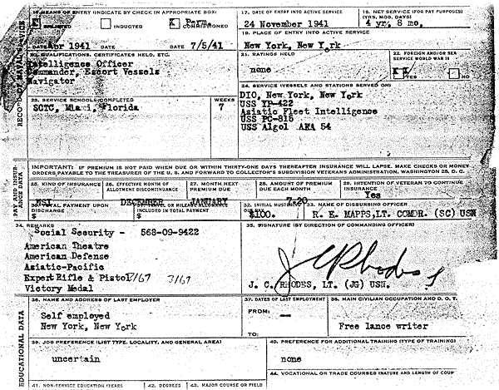
Application/Investigating Committee (cont.)
Examples of some items that may prove eligibility
Separation Document (DD-214)
Performance reports
Travel or medical orders
Medal reports
Morning reports
Assignment listings
Buddy affidavits
Letters from a foreign war zone
Active duty orders showing a qualifying area

Slide 31
Transfers
Applicants who wish to transfer between Auxiliaries need not show proof of eligibility but instead must provide their current membership card as this proves eligibility has been established and approved with their current Auxiliary or as a Member At Large. (Section 106)

Slide 32
Membership
Treasurer’s Guide
This guide walks you through every possible Membership scenario
Can only be found online
Use the web address I gave earlier or just google “VFW Auxiliary treasurer resources” and it will come up
The new MALTA system gives you a roster of all of your members. Presidents, Treasurers, and Secretaries have access to this feature.

Slide 33
“MALTA” Membership System for members
PDF, PowerPoint, and video can be found on-line on the treasurer’s resources page.
www.youtube.com/watch?v=tcBVZ2SBIxM&feature=youtu.be

Slide 34
MALTA Training for Treasurer
PDF, PowerPoint, and video can be found on-line on the treasurer’s resources page.
www.youtube.com/watch?v=ibnj_bAwzAM&feature=youtu.be
MALTA Training

Slide 35
Circle of Excellence
In the 2016-2017 year the National Organization adopted a new award program for Department Presidents. Department Presidents will now have the opportunity to earn their place in the Circle of Excellence, a premier group of members who have proven their leadership. This program replaces the Outstanding Department President awards and gives EVERY Department President the opportunity to achieve recognition for their hard work. Past President Gloria Dobbie was the first Michigan President to be inducted into the Circle of Excellence at the National Convention in New Orleans in 2017.

Slide 36
Circle of Excellence
Support your President by taking care of these items for your Auxiliary:
Growth In Membership-Help your Department reach 100%+ by June 30, 2020, by recruiting new members, and retaining the members you have
Installation Reports-Input online, mail, email, or fax your Installation Report by July 31, 2019
Bonding-Auxiliary President and Treasurer MUST be bonded no later than August 31, 2019
Paid Officers-Auxiliary officers MUST have dues paid by December 31, 2019

Slide 37
Treasurer Questions???

Slide 38
Duties of the Auxiliary Secretary
Per Section 812 of the Bylaws – The Secretary shall keep in books or files:
A current copy of the “Podium Edition Bylaws and Ritual” (you should also have a copy of Robert’s Rules of Order)
A record of all the minutes of each meeting of the Auxiliary
The manner in which the minutes of the Auxiliary meetings are read, printed and/or distributed shall be at the discretion of the Auxiliary by vote of the membership
It is permissible to secure typed or computer generated minutes in the permanent book or insert in a three ring binder or clip folder

Slide 39
Duties of the Auxiliary Secretary (cont.)
Each minute page shall be numbered consecutively and provide a space for the Trustees to sign at audit
The Treasurer’s reports and the audit reports must be incorporated in the minutes, as well as a copy of the yearly bond
Corrections shall be made in the margins
All orders and circulars issued by the National and Department shall be kept in a file. This includes the Michigan Connection
A letter file shall be kept for all correspondence of the Auxiliary.
General correspondence retained for one year
Policy and rulings are maintained permanently

Slide 40
Duties of the Auxiliary Secretary (cont.)
Notify offices the names and addresses of elected and appointed officers
Maintain roll of deceased members with dates of death
Maintain a file, electronically or written, with copies of quarterly reports
Input into MALTA names of Delegates and Alternates to the National within 30 days of election
Transmit the names of Delegates and Alternates to the District and Department within 30 days of election
Read all communications from National or Department at the meetings
Immediately (within 36 hours) following installation, submit the installation report to the National Secretary and the Department Secretary

Slide 41
Minutes of the Meeting
The first paragraph of the minutes whether it be round table, contemporary, or traditional meeting should include the following information:
Name and number of the Auxiliary
Date, place, and time of the meeting
Name of the Presiding Officer and any Substitute Officers
Whether it is a regular or special meeting (if a special meeting, the purpose for which it was called is the only business conducted at that meeting)
Numbers of members present
Names of visitors, if present

Slide 42
Minutes of the Meeting (cont.)
The order of business would be recorded in the minutes as follows:
Opening Ceremonies
Introduction of National and/or Department Officers
Reading and Referring of Applications for Membership. The only part of the application necessary to be read is as follows: “Marilyn Malick, eligible through service member Joseph Malick. Recommended by Erna Dziewit(pronounced Jevit) : )
Voting on Candidates. The result of the ballot and the names of those initiated should be recorded

Slide 43
Minutes of the Meeting (cont.)
Presentation of Minutes of Previous Meeting. After you have read the minutes and they have been approved, write the word “Approved” and the date under your signature
Reading of Official and Other Communications
All communications are grouped under one heading but should be read in the following order: National, Department, District, Post or other Auxiliary communications, and finally thank-you notes, cards and communications from outside organizations
A copy of the Treasurer’s Report shall be incorporated in the minutes

Slide 44
Minutes of the Meeting (cont.)
Presentation of Bills. Read the actual bills separately and give the total. If the Trustees have not yet approved them they should be given to them at this time
Introduction of Guests who are not escorted. At this point in the meeting, any guest(s) may be admitted
Reports of Committees, Standing and Special
VFS should be called upon first, and then the other chairmen, to give their report
Note should be made in the minutes of who made the report, and what action is taken

Slide 45
Minutes of the Meeting (cont.)
Chairman reports are accepted without motion
The Trustees’ report on the audit must be accepted by a motion
Unfinished Business
All business held over from a previous meeting now has the floor
Action by motion on items brought up here should be recorded in the minutes
New Business
Draping of the Charter
Election of Officers-Nomination for each office should be recorded as well as the results of the ballots
Any other action taken should be recorded according to the motions

Slide 46
Minutes of the Meeting (cont.)
Report of Trustees on Bills and Action Thereon. The Senior Trustee makes the report and any member may move to accept the report and pay the bills
Suggestions for the Good of the Order. New members and guests should be invited to speak at this time. Record only a short summary here. A record of the minutes is made up of what is done, not what is said
Closing Ceremonies. The Secretary should finish minutes by writing something like this: “Closing ceremonies were conducted according to the Ritual, and the meeting was adjourned. The next meeting will be ________(date).”

Slide 47
Helpful Hints
Because the minutes are a permanent record of the Auxiliary, be detailed when recording the motions, as to who made and seconded the motion using first and last name, and if the motion passed or failed
The minutes can briefly describe the chairman’s reports. Detailed reports from chairmen can be kept on file. When reading the minutes from the previous meeting, the Secretary can report that the chairman’s reports were given
When reading the Treasurer’s report of the previous meeting, it is only necessary to read the starting balance, total receipts, disbursements, and ending balance

Slide 48
Helpful Hints (cont.)
Recording the meeting
May only be used to supplement notes
May not be distributed to those who did not attend the meeting
Recording equipment must be in full view of the members
May not use if members object
Ask your Chairmen to submit a copy of their report for your records
Bulletins are uploaded to the website every two months. Each month has its own bulletin this year.

Slide 49
Other Duties of the Secretary
Notify the Auxiliary from which a member has transferred (Sec. 106A)
Notify the Department and District when the meeting date, time and/or location has changed
Notify the Department and District when an officer has changed
Keep a copy of the Standing Rules
Date and affix the Seal of the Auxiliary to all communications and sign your name in ink
Questions???

Slide 50
Trustees
Per Sections 802 and 804 of the Bylaws:
Each Auxiliary and District shall have 3 elected Trustees
One Trustee shall be elected for a term of three years at the time Officers are elected each year
Each Auxiliary and District will have:
A First Year Trustee (also known as Senior Trustee) who will serve as the Chairman of the Trustees
A Second Year Trustee
A Third Year Trustee

Slide 51
Duties of Trustees (Sec 814)
Properly audit the books and records of the VFW Auxiliary Treasurer and Secretary
Complete the audit and forward a signed accepted copy of the audit to the Department Treasurer no later than the end of the month following the expiration of each quarterly period. If your meeting is before you do the audit you will need to get an extension. The Department President is the only person who can grant an audit extension.

Slide 52
Duties of Trustees (Sec 814)
Quarter | Months | TO DEPARTMENT TREASURER NO LATER THAN
First | Jan – Mar | April 30th
Second | Apr – Jun | July 31st (Both outgoing and incoming Treasurers and Trustees should be present)
Third | Jul – Sep | October 31st
Fourth | Oct – Dec | January 31st
These dates may be changing at the 2019 National Convention; stay tuned.

Slide 53
Duties of Trustees (Sec 814)
Sign and date all pages attached to the record books at the audit
Submit and read the written audit report at the Auxiliary meeting
Verify all expenditures of the VFW Auxiliary and certify by their signatures to the correctness of each bill before payment may be made
Audit the records and accounts of all committees, Officers and members having to do with the receipt and expenditure of the VFW Auxiliary funds
Perform other duties incident to the office as the VFW Auxiliary may direct or the law require
990-N ePostcard filing, 8822-B filing, other tax forms
See that the offices of President and Treasurer are bonded with an indemnity company authorized by National Headquarters or the Department

Slide 54
Duties of Trustees (Sec 814)
See that the offices of President and Treasurer are bonded with an indemnity company authorized by National Headquarters or the Department

Slide 55
Duties of Trustees (Sec 814)
All audits are to be completed by the elected Trustees
A minimum of two Trustees are to be in attendance; (1) must be an elected trustee
The President, Secretary, and Treasurer should attend the audit
A pro-tem can be appointed to audit the books under extenuating circumstances
The Senior Trustee serves as Chairman and shall call the meetings for the audits
If a Trustee resigns for any reason, the Auxiliary will elect a member to fill the un-expired term of that particular Trustee

Slide 56
Duties of Trustees
Negligence on the part of the Trustees in carrying out the mandates of Bylaws Section 814, or in attending the audits, shall make them individually and collectively responsible, with any others, for any discrepancy
Bylaws Section 309 states that any VFW Auxiliary in arrears for failure to bond and/or make quarterly audits will be deprived of VFW Auxiliary representation on all levels

Slide 57
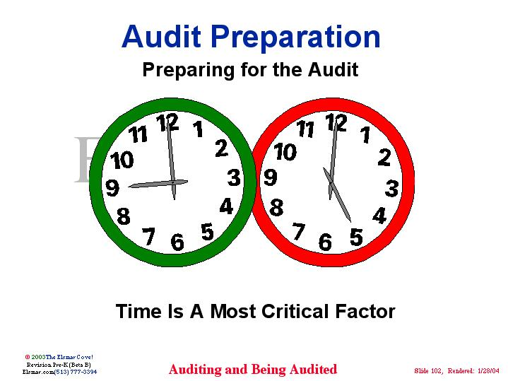
Audit Preparation
These items shall be available to the Trustees:
Permanent record books of the Treasurer and Secretary
Checkbooks
Savings books or investment information, if any
Bank statements
Receipt book
Membership records and reports
Minutes of each meeting
Copy of the most recent audit
Copy of the Standing Rules
Blank Audit Forms

Slide 58
Performing an Audit
Review and check Treasurer’s book against the checkbook to ensure all receipts and expenditures are listed
Cash receipt book transactions listed in Treasurer’s book
Receipts in Treasurer’s book = deposits
Expenditures in Treasurer’s book = checks written
Reconcile Bank Statements
Review canceled checks and compare to checkbook and Treasurer’s book
List outstanding checks by check number and amount
List outstanding deposits by date and amount
Balance of bank statement + outstanding deposits – outstanding checks = balance of checkbook

Slide 59
Performing an Audit
Review and check Secretary’s minutes to ensure that all expenditures other than membership transmittals were either authorized by a motion or are in the VFW Auxiliary’s standing rules
Compare Auxiliary dues against National’s reports
In MALTA the Auxiliary Officers can run reports for membership
Ensure that every member that pays dues shows as paid in National’s reports

Slide 60
Performing an Audit
Trustees are to report, not correct, any errors that they may find in the Secretary’s or Treasurer’s records
It is the duty of the Secretary or Treasurer to make the necessary corrections in their records
The Trustees shall sign and date the audit after all mistakes, if any, have been corrected

Slide 61
Performing an Audit
Suggested Tasks for 1-Year Trustee (Chairman)
Review the checkbook against canceled checks and deposits
List outstanding checks by check number and amount; list outstanding deposits by date and amount on audit report form
Reconcile bank statement with the checkbook
Reconcile all dues against national membership reports
Read totals from previous audit as beginning balances of current audit
Sign and date reverse side of last checkbook stub, last receipt stub, and last bank statement. Sign and date Secretary’s book and Treasurer’s book
Review, date, and sign the completed audit form
Send a copy of the completed audit to the Department Treasurer

Slide 62
Performing an Audit
Suggested Tasks for 2-Year Trustee
Review and check the bank statement to match canceled checks to match expenditures
Review and check the deposits and compare with receipts
Total all receipts; total all disbursements and calculate new cash balance
Read totals to 1-Year Trustee for incorporation into audit form
Ensure that all appropriate tax forms have been filed (990-N ePostcard, Form 8822-B, bingo licensing, etc.)
Sign and date reverse side of last checkbook stub, last receipt stub, and last bank statement. Sign and date Secretary’s book and Treasurer’s book.
Review, date, and sign the completed audit form

Slide 63
Performing an Audit
Suggested Tasks for 3-Year Trustee
Read from Treasurer’s book receipts and expenditures
Review Secretary’s minutes for authorization of expenditures, other than membership transmittals and expenditures authorized by standing rules
Prepare the audit report form on basis of information from other Trustees
Sign and date reverse side of last checkbook stub, last receipt stub, and last bank statement. Sign and date Secretary’s book and Treasurer’s book
Review, date, and sign the completed audit form

Slide 64
Audit
Trustees prepare and sign the audit report, NOT THE TREASURER
A copy of the accepted audit must be given to the Secretary to incorporate it into the minutes
The audit should be conducted in an environment conducive to conducting business
The President, Treasurer, and Secretary should attend the audit in addition to the Trustees
At the 2nd quarter audit meeting the outgoing and incoming Treasurer and Trustees should be present

Slide 65
Building on the VFW Auxiliary Foundation
It is a set of five guidebooks to assist members, Chairmen and Officers with the duties of their positions.
A digital PDF of the guide can be found on the Resources page of the website at vfwauxiliary.org/resources.

Slide 66
Building on the VFW Auxiliary Foundation (cont.)
Guidebook 1: All officer and appointed positions and other resources and guidelines.
Guidebook 2: Information on programs, Chairmen duties, and reporting assistance.
Guidebook 3: Extension information and assistance in membership.
Guidebook 4: Description of duties for the National District Council Members.
Guidebook 5: Financial responsibilities, such as Treasurer duties and the function of the Audit Committee.

Slide 67
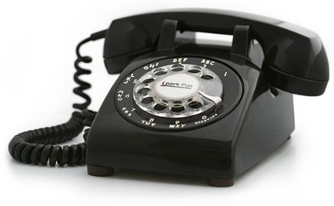
Any other Questions????
We hope that this day was informative and interesting. We are only a phone call, email, text or message away from answering your questions.

Slide 68
Contact Information
Della Steege-Department President
(989)666-7732
district9della@yahoo.com
Marilyn Malick, Department Chief of Staff
(586)536-6004
mjmalick@msn.com
Nicole Koutz-Department Treasurer
(517)487-3715
mitreas@asiserve.net
Cindy Peto-Department Secretary
(517)487-3715
misec@asiserve.net

